Slide 1

Introduction to computational RNA biology: splicing, translation and networks
Computational methods for alternative splicing identification
Dr Thiago Britto Borges
March 2022
thiago.brittoborges@uni-heidelberg.de or @tbrittoborges

Slide 2
Outline
A perspective to differential splicing
Using workflows managers
Workflows for detecting alternative splicing
Workflow to discover new transcript isoforms
My main goal here is to present concepts and give a brief introduction of the selected programs
Notes:
introducing RNA-seq and read processing and mapping please

Slide 3
A perspective to differential splicing
Here we aim to link the biological concepts to the RNA-seq analysis.
In addition, we define elements of the gene annotation and other concepts

Slide 4
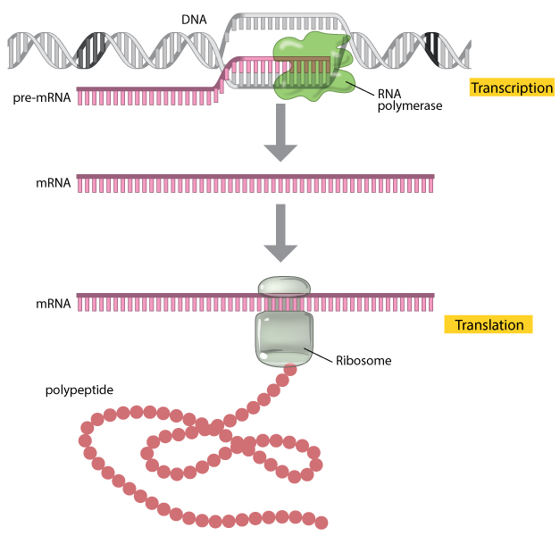
The central dogma of molecular biology
Clancy, S., and W. Brown. "Translation: DNA to mRNA to." Nature Education (2008).

Slide 5
Splicing
RNA processing
(including splicing)
Mature mRNA
Modified from Clancy, S., and W. Brown. "Translation: DNA to mRNA to." Nature Education (2008).

Slide 6
Important remark on RNA processing
Splicing is not the only process that leads to differential RNA transcript isoforms (and later protein isoforms).
There is RNA processing comprised of complex series of enzymatic steps that mature the RNA.
Splicing, the enzymatic removal of introns, is one of them.
The RNA molecule, comprised only of exons and fully processed, and then is exported to the cytoplasm and then is considered mature.
mRNA molecules will be translated to proteins.

Slide 7
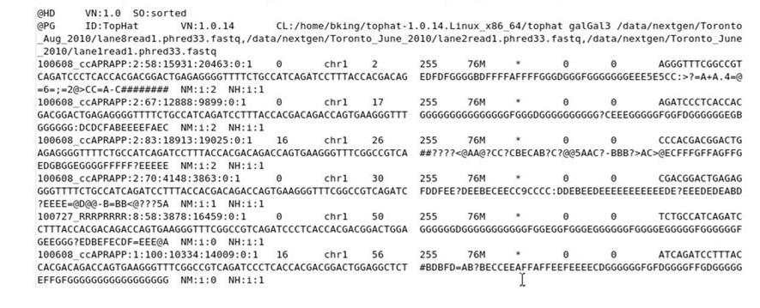
Sam/Bam file format
Position
CIGAR string
Sequence
header section
Read name
alignment section

Slide 8
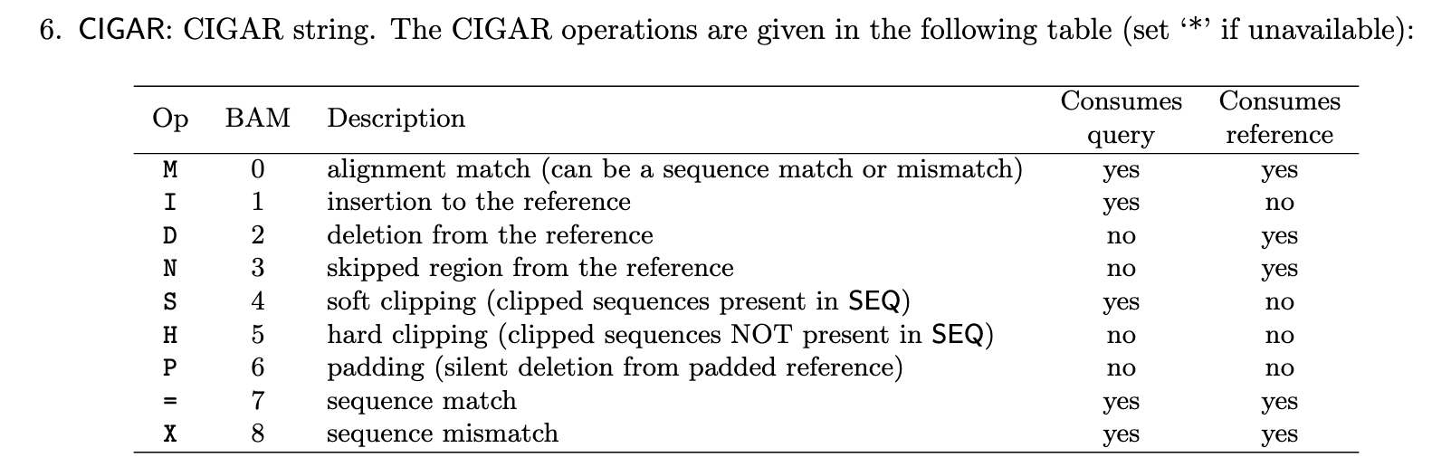
CIGAR description
From http://samtools.github.io/hts-specs/SAMv1.pdf

Slide 9
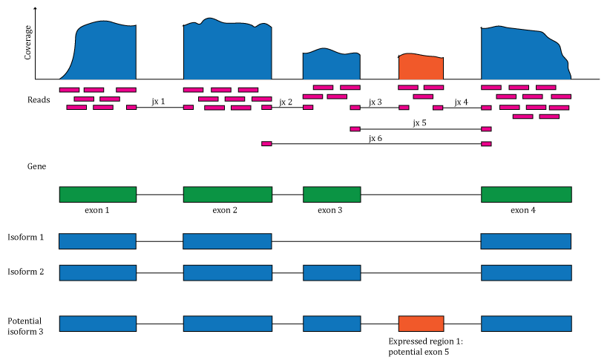

Slide 10
Two approach for alternative splicing identification
Differential Transcript Usage or expression
Differential Junction Usage or expression

Slide 11
Splicing leads to different transcript isoforms
Alignment visualization with IGV

Slide 12
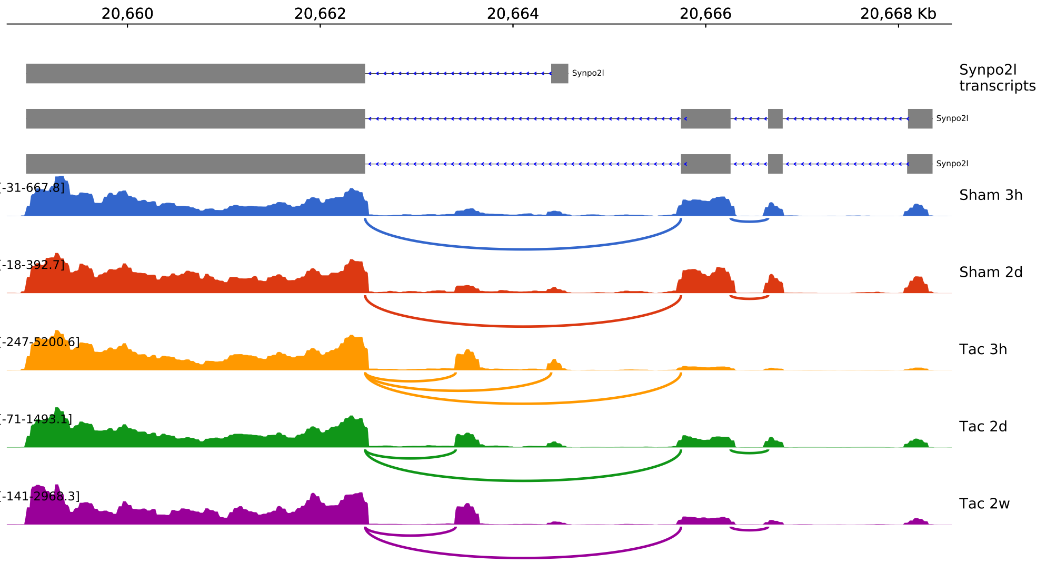
Alternative isoforms may be relevant for disease conditions

Slide 13
The split-read
The split-read, the read alignment with the N cigar, is the empirical evidence from the RNA-seq experiment that an intron was removed.

Slide 14
Using workflows managers
Why we need a workflow managers?
What is workflow portability?
Basic elements of a SnakeMake workflow

Slide 15
Elements of a workflow operation
Software,
parameters
Input
Output

Slide 16
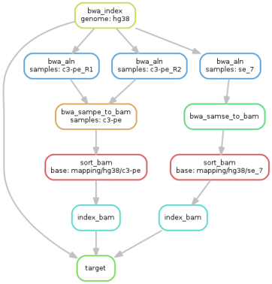
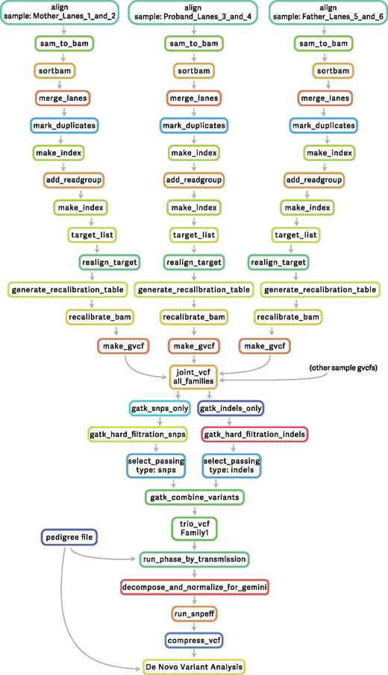
Examples of workflows operations

Slide 17
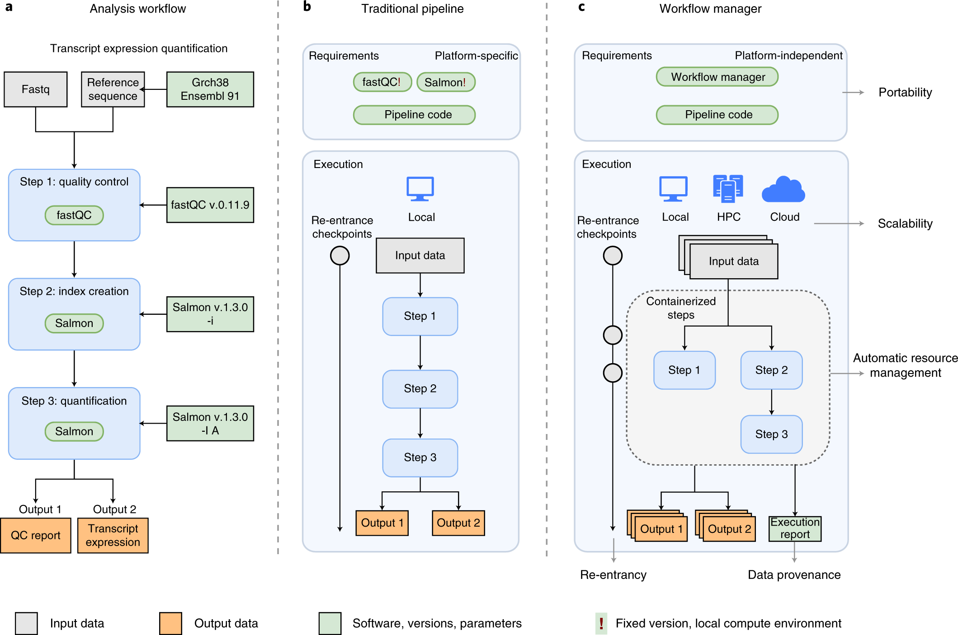
Different approaches for multi-step, data intensive tasks
Wratten et al., 2021
Notes:
A: Manual sequential running every step of the workflow
B: Traditional pipeline implementations, with scripts/make files - conditional to compute environment, sensible changes
C:
A > B: much simpler to repeat the process
Requirements are portable as it use Software environments or containers
Manager deal with task scheduling, scalability is not an issue anymore

Slide 18
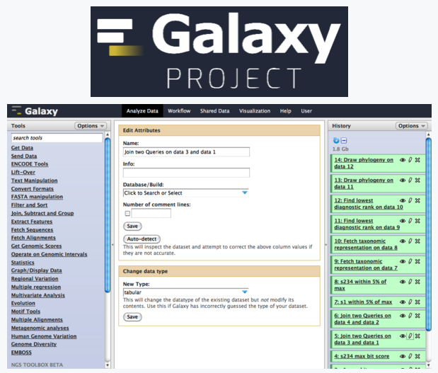

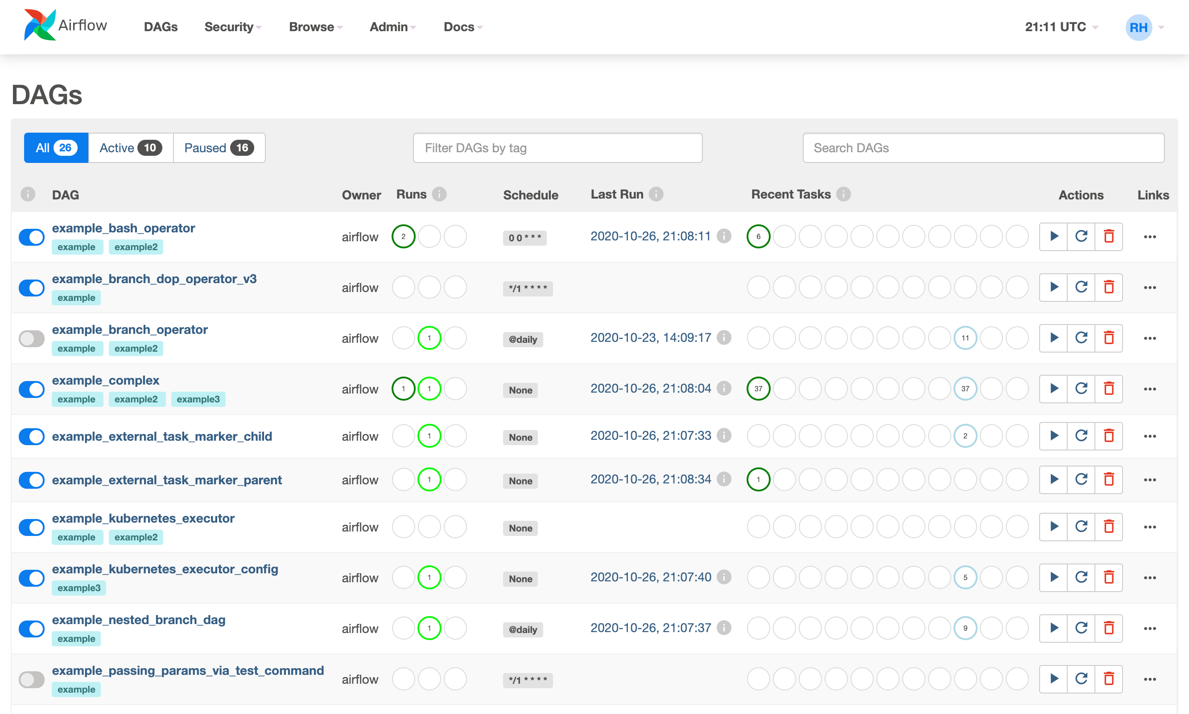
Examples of domain specific workflows managements tools with different target audience
Notes:
- Dask
- Drake

Slide 19
Galaxy targets researchers without computer programming experience
Notes:
Galaxy is interesting for users how don’t want to code. The tradeoff is having to upload data to external servers.
Galaxy is also interesting as way to make workflows easily accessible to others.
One barrier right now is that there many instances of galaxy, supporting different tools

Slide 20
Airflow is used by data scientists
Airflow is a platform created by the community to programmatically author, schedule and monitor workflows.
Used for deployment with AWS, Kubernetes or Azure
Notes:
Lugi and many others

Slide 21
Overview of workflow managers for bioinformatics
Wratten et al., 2021
Notes:
Please refer to Supplementary Table 1 for details. This information is based on online documentation and manuscripts and may not be reflective of the current state of the projects. Scores for Galaxy are based on the graphical user interface.
ªEase of use: graphical interface with execution environment (score of 3), programming interface with in-built execution environment (score of 2), separated development and execution environment (score of 1).
^{b}Expressiveness: based on an existing programming language (3) or a new language or restricted vocabulary (2), primary interaction with graphical user interface (1).
^{c}Portability: integration with three or more container and package manager platforms (3), two platforms are supported (2), one platform is supported (1).
^{d}Scalability: considers cloud support, scheduler and orchestration tool integration, and executor support. Please refer to Supplementary Table 1.
^{e}Learning resources: official tutorials, forums, and events (3), tutorials and forums (2), tutorials or forums (1).
^{f}Pipelines initiatives: community and curated (3), community or curated (2), not community or curated (1).

Slide 22
Why to use SnakeMake
Snakefiles are Python code (+ yaml)
Feature rich
Domain specific (bioinformatics)
HPC first, but also can be used with Kubernetes/AWS
Rules are modular, we can re-use them (reduce duplication)
Automatic documentation with software version tracking
Workflow continuous integration testing, keep track of results changes on version change
Archive of ready-to-use rules: snakemake-wrappers and workflows

Slide 23
SnakeMake comprises:
Snakefile
Configuration file
Metadata file
Cluster, environment

Slide 24
Rules are the building blocks of a SnakeFile
Task is executed if:
The target output is not found
The input file is newer than the target output

Slide 25
Snakemake-workflow

Slide 26
Workflow for variant calling

Slide 27
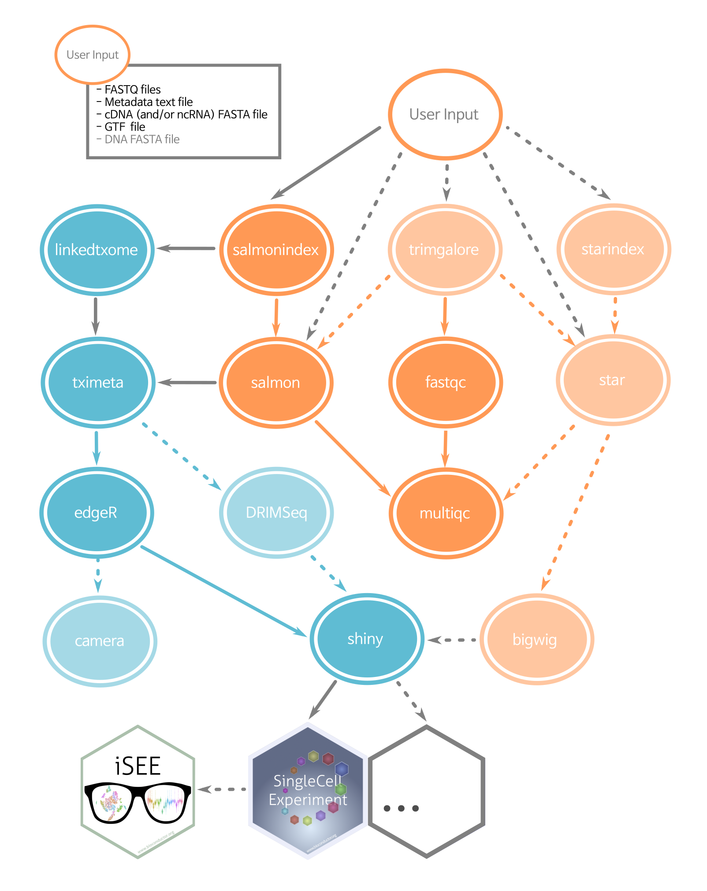
Workflow for RNA-seq

Slide 28
Workflows for detecting alternative splicing
Complex pipelines using multiple workflows

Slide 29
Pre-build rules

Slide 30

Example of end-to-end Snakemake workflow
https://github.com/dieterich-lab/Baltica
Britto-Borges, Thiago, et al. "Baltica: integrated splice junction usage analysis." bioRxiv (2021).

Slide 31
Cluster config (simplified example)

Slide 32
Workflow to discover new transcript isoforms
Applying workflow managers to find novel transcript isoforms.

Slide 33
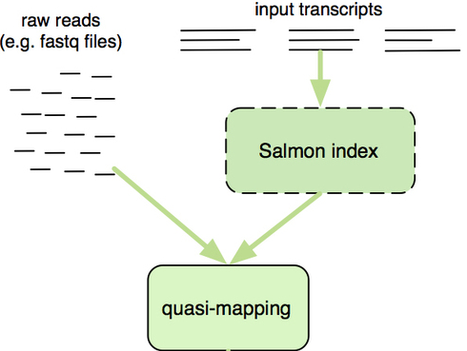
Salmon quantify transcripts without read alignment
Salmon allows accurate and fast transcript abundance using quasi-mapping methodology
Transcript abundance

Slide 34
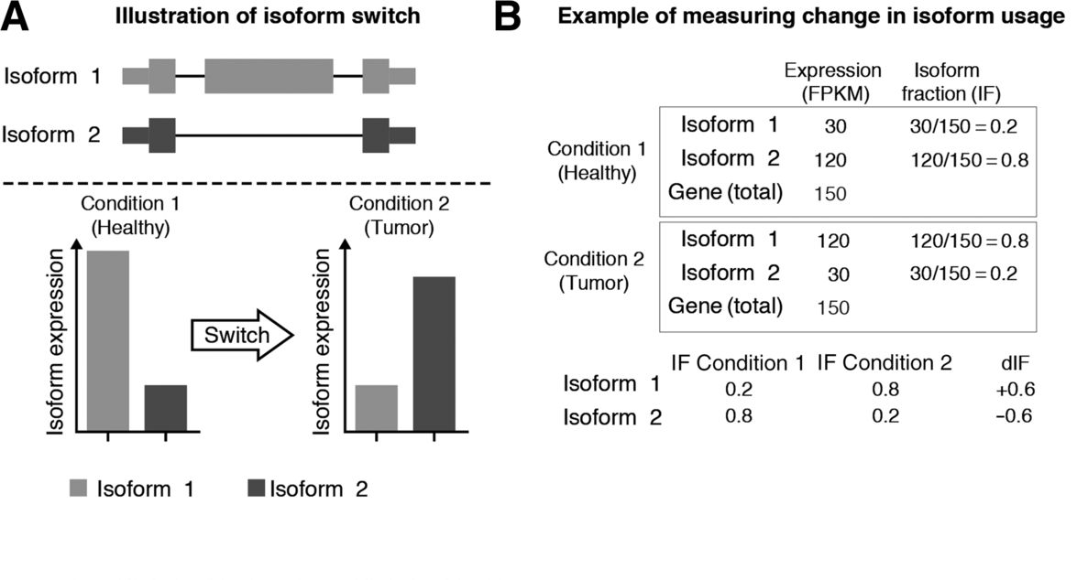
DRIMSeq
DRIMSeq is an R package that uses generalized linear modelling to identify isoform switches from estimated isoform count data.
Uses Dirichlet-multinomial (DM) model
Nowicka, Malgorzata, and Mark D. Robinson. "DRIMSeq: a Dirichlet-multinomial framework for multivariate count outcomes in genomics." F1000Research 5 (2016).
Vitting-Seerup, Kristoffer, and Albin Sandelin. "The landscape of isoform switches in human cancers." Molecular Cancer Research 15.9 (2017): 1206-1220.

Slide 36
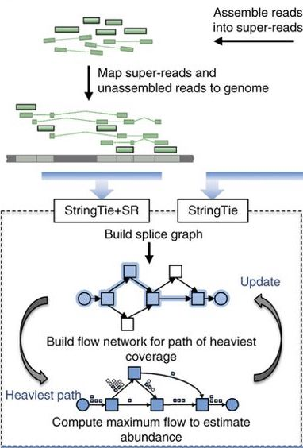
StringTie finds paths on the splice graph to detect

Slide 37
More detailed look into a simple rule

Slide 45
Containers, docker and Singularity
Workflow manager allow software execution independent of local infra-structure (portability feature)
A unit of software and its dependencies packaged within an isolated environment
Docker is an industry-standard, proprietary container solution
Singularity is a popular container system for HPC. It allows secure, portable, and reproducible workflows

Slide 46
Docker (Containerized Bioinformatics)

Slide 47
Summary
There are different types of analysis beyond differential gene expression analysis
Differential splicing identification can reveal important information of pos—transcriptional information for RNA-seq datasets
Workflow managers have advantages over running simple scripts
Please check Further-Reading

Slide 48
Any questions?

